Slide 1
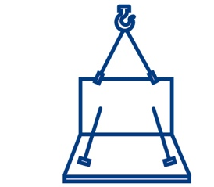



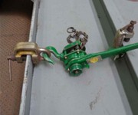
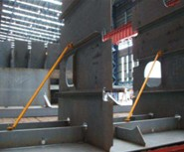
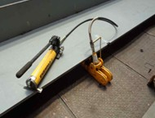
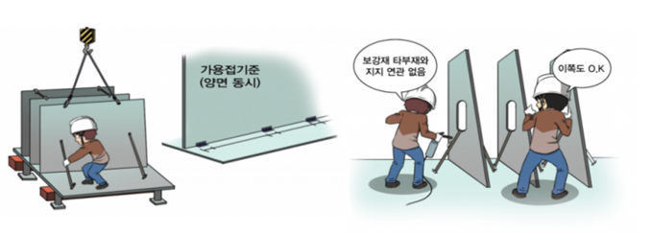
Installation
Safety Operation Guide
2025-외국인전담팀-243
Installation of Vertical Members
Description
Method
Main
equipment
used
Assembling the contact area where the surface of one member meets the surface of another according to the blueprint to form the ship’s structure
Mark the assembly position on the base plate → Adjust the height and align precisely (use cranes, hydraulic ram, lever puller, and various jigs) → Tack weld* → Secure each component
*Tack welding: Temporary welding before final welding to hold components in place and prevent structural deformation or twisting
Cranes, lever pullers, hydraulic rams, oxygen cutters, CO2 welders, hammers, air hoses, etc.
Adjust misalignment using a lever puller
Secure vertical members using supports
Adjust the base plate misalignment using hydraulic rams
See if the support is connected to other members before removing it.
Tack welding criteria (weld both sides simultaneously)
It looks good here, too.

Slide 2


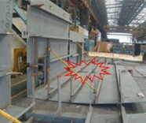
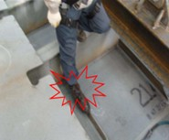
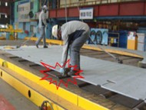
1
Major Hazards
Crushing and tipping Hazards
• Risk of being crushed due to vertical members tipping over when clamps are removed before installing anti-tipping jigs
• Risk of being crushed when the base plate detaches from the clamp and hits a structure while being moved by a crane
• Risk of tipping due to unstable hydraulic rams or securing jigs failure
• Risk of tipping due to failure of tack welds on securing pieces during fit-up welding
Struck-by hazard
• Risk of flying debris as the lever puller hook slips off the secured steel plate or the securing piece* breaks
* Securing piece: A welded metal piece on the member to secure it with the lever puller hook
Risk of being struck when the lever puller hook bounces due to overloading or improper hooking during installation
Tripping and pinch hazards
• Risk of slipping or tripping while stepping over vertical members (e.g., beams) on base plates
• Risk of being pinched during installation when a bracket falls, and fingers get caught between the bracket and the floor
Other hazards
• Risk of burns from welding sparks during fit-up welding
• Risk of electric shock from insulation damage to electrical cable connections during fit-up welding
• Risk of health issues from welding fumes during fit-up welding
Risk of being crushed by falling vertical members
Risk of tripping over vertical members
Risk of body parts getting caught between base plates

Slide 3
2
Safety Measures
Crane
• Check the installation of an anti-tipping jig during crane rigging.
• Perform tack welding or install anti-tipping support before separating the crane hook.
• Check for severe deformation or damage (e.g., hook and road chain separation, cracks) on the lever puller.
Before using hydraulic rams, check for hydraulic pump and oil leakage deformation and ensure stable installation on the ground.
Fit-up welding
Remove combustible materials around the work area during fit-up welding; otherwise, take measures to prevent sparks.
Check for damage or wear on hoses and blowpipes before fit-up welding.
Lever puller
• When using the lever puller, ensure the hook and chain are aligned.
• Do not leave the lever puller on the members for extended periods.
• When using a lever puller, do not hold the chain under while a load is applied. Be mindful of possible breakage and work from the side of the hook, not the front.
3
Key Inspections
Check whether supports of appropriate specifications and shape are installed according to the block conditions.
For block members, check the center of gravity.
Before removing the crane hook, ensure tack welding or anti-tipping supports are installed on both sides.
When removing supports, check their relation to other members and ensure they are fully tack-welded on both sides.
Before cutting member supports, ensure no workers are nearby.
Check for combustible materials at the fit-up welding site.
Check the lever puller hook and chain for damage or deformation.

Slide 4
4
Major Hazards (Example)
① Work preparation
Hazards
Measures
Rules on Occupational Safety and Health Standards
Article 3, Article 22
Article 146
Article 32, Article 34
Risk of tripping while moving to the work position
Secure a safe passage by keeping the area organized.
Risk of falling or collision when transporting members with a crane.
Prohibit access beneath crane transport operations.
Risk of injury when wearing damaged protective equipment.
Wear proper protective equipment; inspect its condition and replace defective gear.
② Installation of vertical members
Risk of tipping over a heavy load due to a defective lever puller
. Check the hooks and chains for deformation or damage before work.
. Follow the rated load capacity when using lever pullers and chain blocks.
Article 96
Article 43
Article 3
Article 301
Article 32
Article 629
Risk of falling through an opening while moving members
. Implement protective measures (e.g., covers) for openings before work.
Risk of workers being trapped due to members falling over from defective tack welding.
. Install each member according to appropriate standards and use supports to prevent tipping.
Risk of electric shock from exposed welding cable conductors.
. Check cable insulation before work and maintain its performance.
Risk of burns from welding sparks and eye injury from arc light.
. Wear safety glasses or a face shield with sufficient shading to protect eyes from harmful radiation during welding.
Risk of health hazards from welding fumes and toxic gases during welding.
. Ensure ventilation during work and wear appropriate respiratory protection (e.g., a combination dust/gas mask for materials with paint, grease, or coatings; an air-supplied mask for confined spaces with asphyxiation risk).
③ Finishing after work
Risk of tripping while disassembling and cleaning the welding machine.
. Check and organize the surroundings to secure a safe passage.
Article 3, Article 22

Slide 5


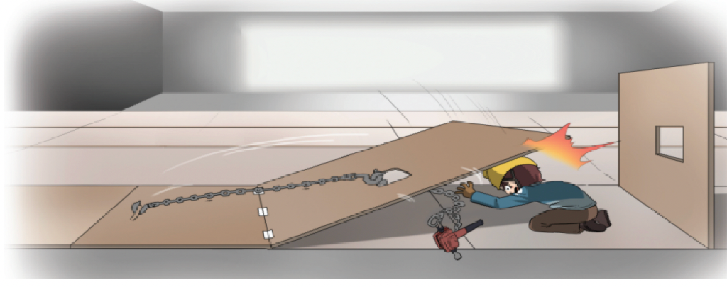
!
Accident Case Crushed by a vertical member that tipped over due to weak tack-welds
Summary
A worker at the block drying company was installing a vertical member onto a base plate using a lever puller. When he applied load, the tack weld broke, causing the member to tip over and crush the worker.
Causes
Failure to implement measures to prevent tipping of vertical members
There was no overhead support to support the vertical members during welding.
No supports or reinforcements were installed.
Failure to comply with tack welding standards
The tack welding standards were not observed, and only one side of the vertical member was welded.
Preventive Measures
Thorough prevention of vertical member tipping
During the installation of vertical members, secure an overhead support using a crane.
Install supports or reinforcements on both sides.
For block members, check the center of gravity and assess the risk of tipping.
Strict compliance with the tack welding standards
  When tack-welding vertical members, follow the company standards and tack-welding guidelines and weld both sides simultaneously under strict supervision.

